Slide 1
STUDENT NAME: J. Rahul
REGISTER NO AND NMID: 24bca152 AAFF72177FFFFF59FEA44454645F27D0
DEPARTMENT: BCA Computer application
COLLEGE: Mohamed Sathak College of Arts and Science

Slide 2
P_{D}RO_{I}JE_{G}CT_{I}T_{T}ITL_{A}E _{L}
PORTFOLI O

Slide 3



AGENDA
Problem Statement
Project Overview
End Users
Tools and Technologies 5.Portfolio designand Layout
Features and Functionality
Results andScreenshots
Conclusion
3/21/2024Annual Review
8. Github Link
1

Slide 4


PROBLEM STATEMENT
In today’s competitive digital world, individuals lack a centralized, professional, and visually
appealing platform to showcase their academic achievements, skills, and projects.
A digital portfolio is necessary to present
personal and professional information effectively.

Slide 5

PROJECT OVERVIEW
TheDigital Portfolio Websiteis a personal platform designed to highlight academic, technical, and creative skills.
It contains sections such as About Me, Education,
Projects, Skills, Certifications, and Contact information.
The website is responsive, user-friendly, and customizable.

Slide 6
WHO ARE THE END USERS?
Students – Showcase academic achievements and skills Job Seekers – Highlight projects and certifications Professionals – Build an online personal brand Recruiters/Employers – View candidate portfolios easily

Slide 7


TOOLS AND
TEFrCoHntNenIdQ: HUTEMSL, CSS,JavaScript, Bootstrap
Backend: Python (Flask/Django) or PHP (if required)
Database: MySQL / SQLite (optional)
Hosting: GitHub Pages / Netlify Version
Control: Git & GitHub

Slide 8

POTFOLIO DESIGN AND LAYOUT
The design follows a clean, minimal, and
professionallayoutwith proper
navigation. Sections include:Home, About, Skills,
Projects, Education, Certifications, and Contact.
The portfolio desktop and mobiledevices.
is responsivefor both

Slide 9
FEATURES AND
FUUseNr-fCrieTndIlOy inNteArfaLceITwiYthsmooth navigation Responsive design for mobile and desktop
Sections for About, Projects, Skills, and Contact
Integration with LinkedIn/GitHub Downloadable Resume option

Slide 10
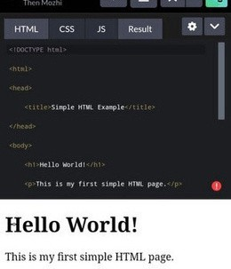
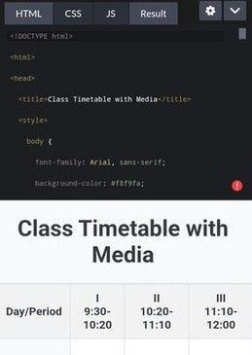

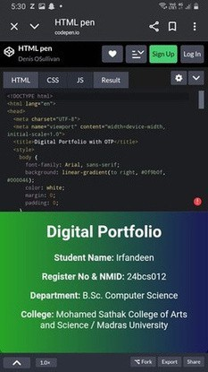
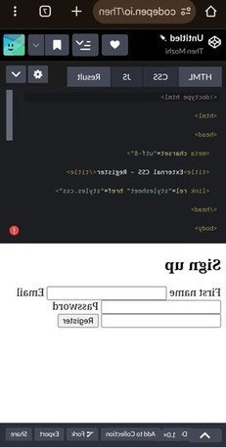
RESULTS AND SCREENSHOTS
3/21/2024Annual Review
10

Slide 11
CONCLUSION
The DigitalPortfolio Website providesan organized and professional wayto present personalachievements,skills, and projects.
It enhances careeropportunities and creates a strongdigitalpresence
10

